Slide 1
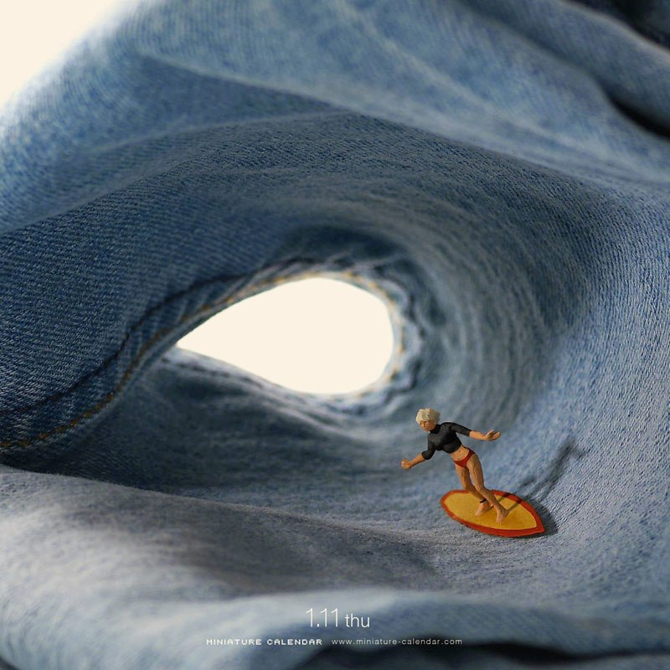
What can you tell me about this image?

Slide 2
Take notes on his work for your reference page

Slide 3
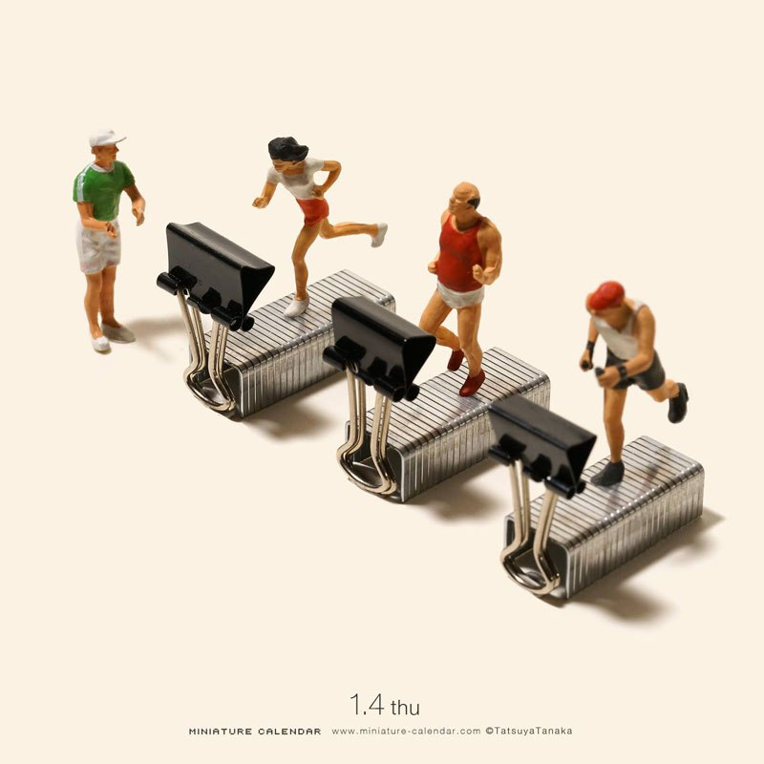
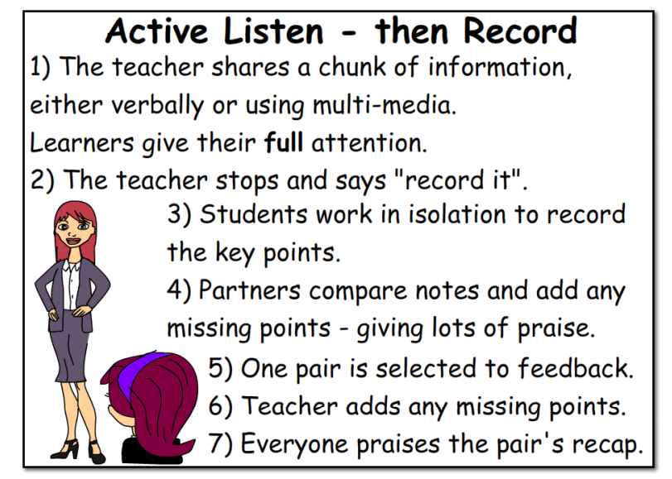
Tanaka Tatsuya .
Born in 1981 in Kumamoto Prefecture.
Tanaka used to work at a design company, planning magazine advertisements as an art director. SinceApril 20th, 2011, Japanese artist Tatsuya Tanaka has created and published a miniature artwork every single day. The aptly titled project, Miniature Calendar, combines photography, art direction, a continually growing collection of miniatures, and every day objects repurposed and reimagined into something entirely different yet instantly recognizable.
Tanaka has not only continued with the daily ritual, creating over 2,000 scenes in the process, but he has continued to evolve and elevate his craft, finding new ways to see the world around him and stay creative.
He has more than a million followers on Instagram.

Slide 4
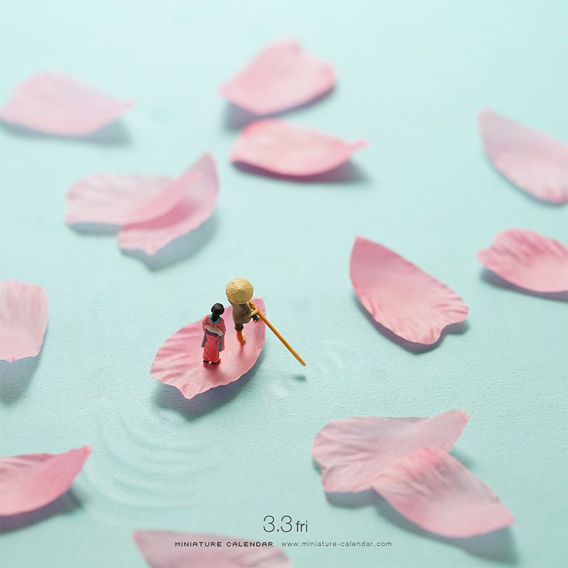
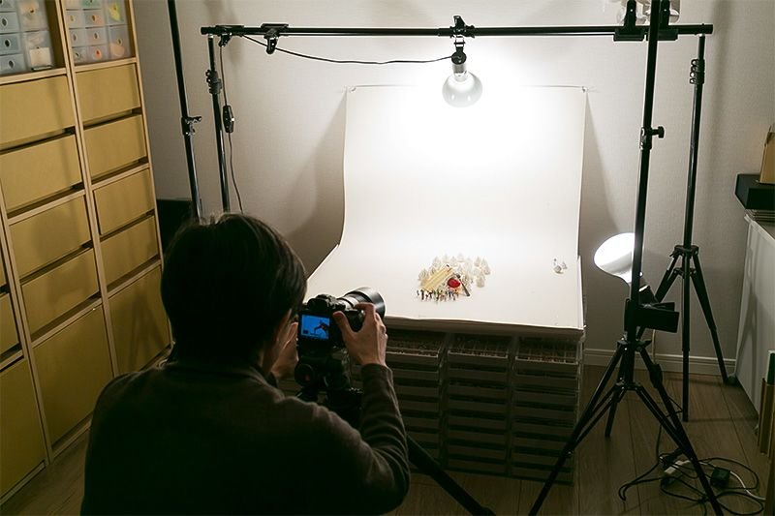
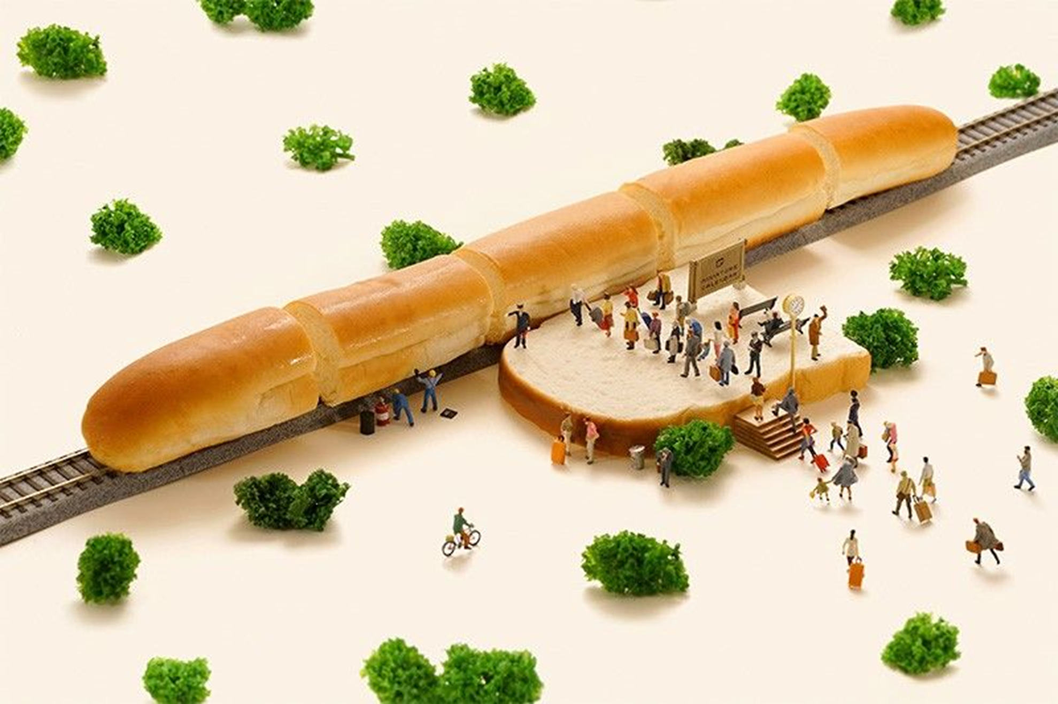
Tanaka setting up his photo shoot

Slide 5

What can you tell me about this image?

Slide 6
Take notes from the presentation to help with your reference page

Slide 7
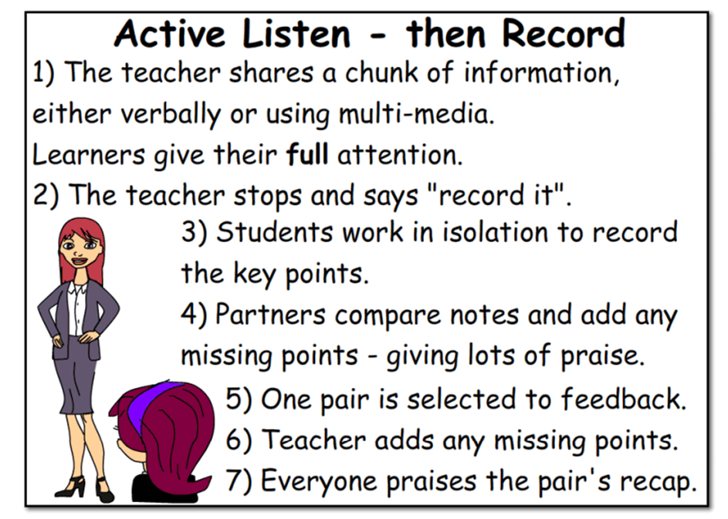

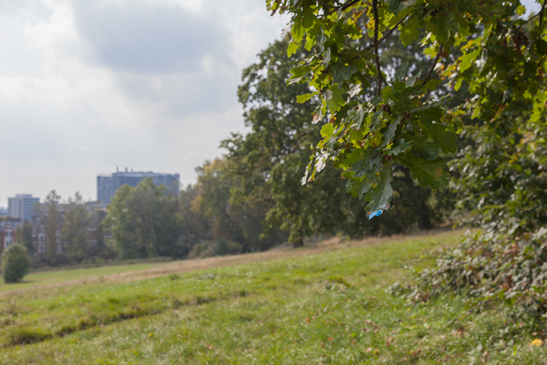
Slinkachu (Male/33/UK)
The 'Little People Project' started in 2006. It involves the remodelling and painting of miniature model train set characters, which I then place, photograph and leave on the street. It is both a street art installation project and a photography project.
The street-based side of my work plays with the notion of surprise and I aim to encourage city-dwellers to be more aware of their surroundings. The scenes I set up, more evident through the photography and the titles I give these scenes, aim to reflect the loneliness and melancholy of living in a big city, almost being lost and overwhelmed. But underneath this, there is always some humour. I want people to be able to empathise with the tiny people in my works.

Slide 8
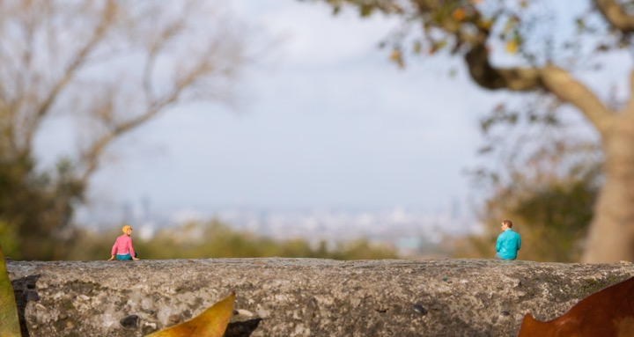
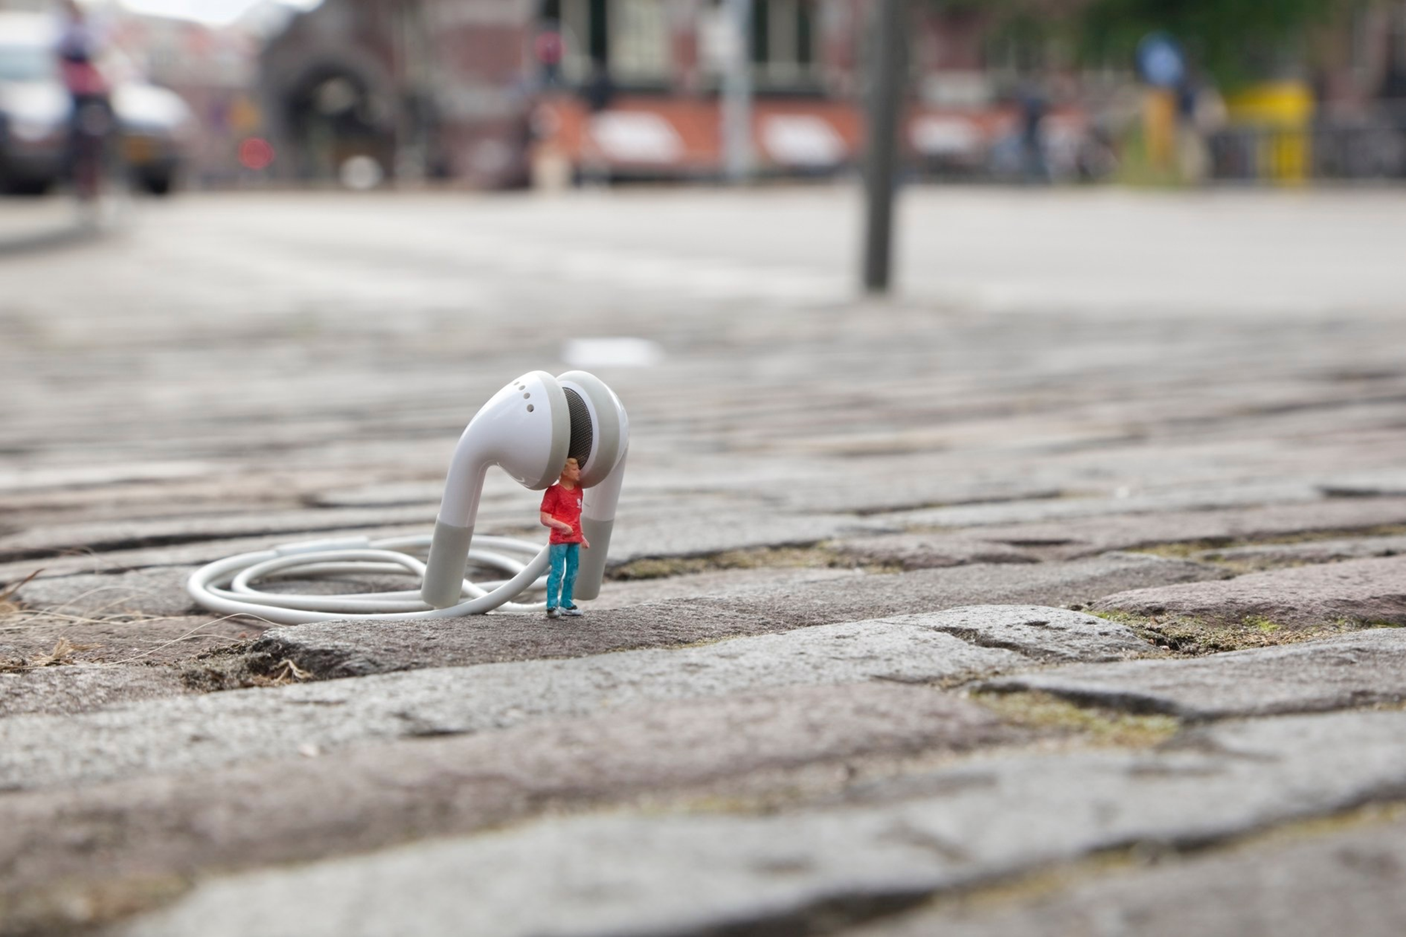

Slide 9
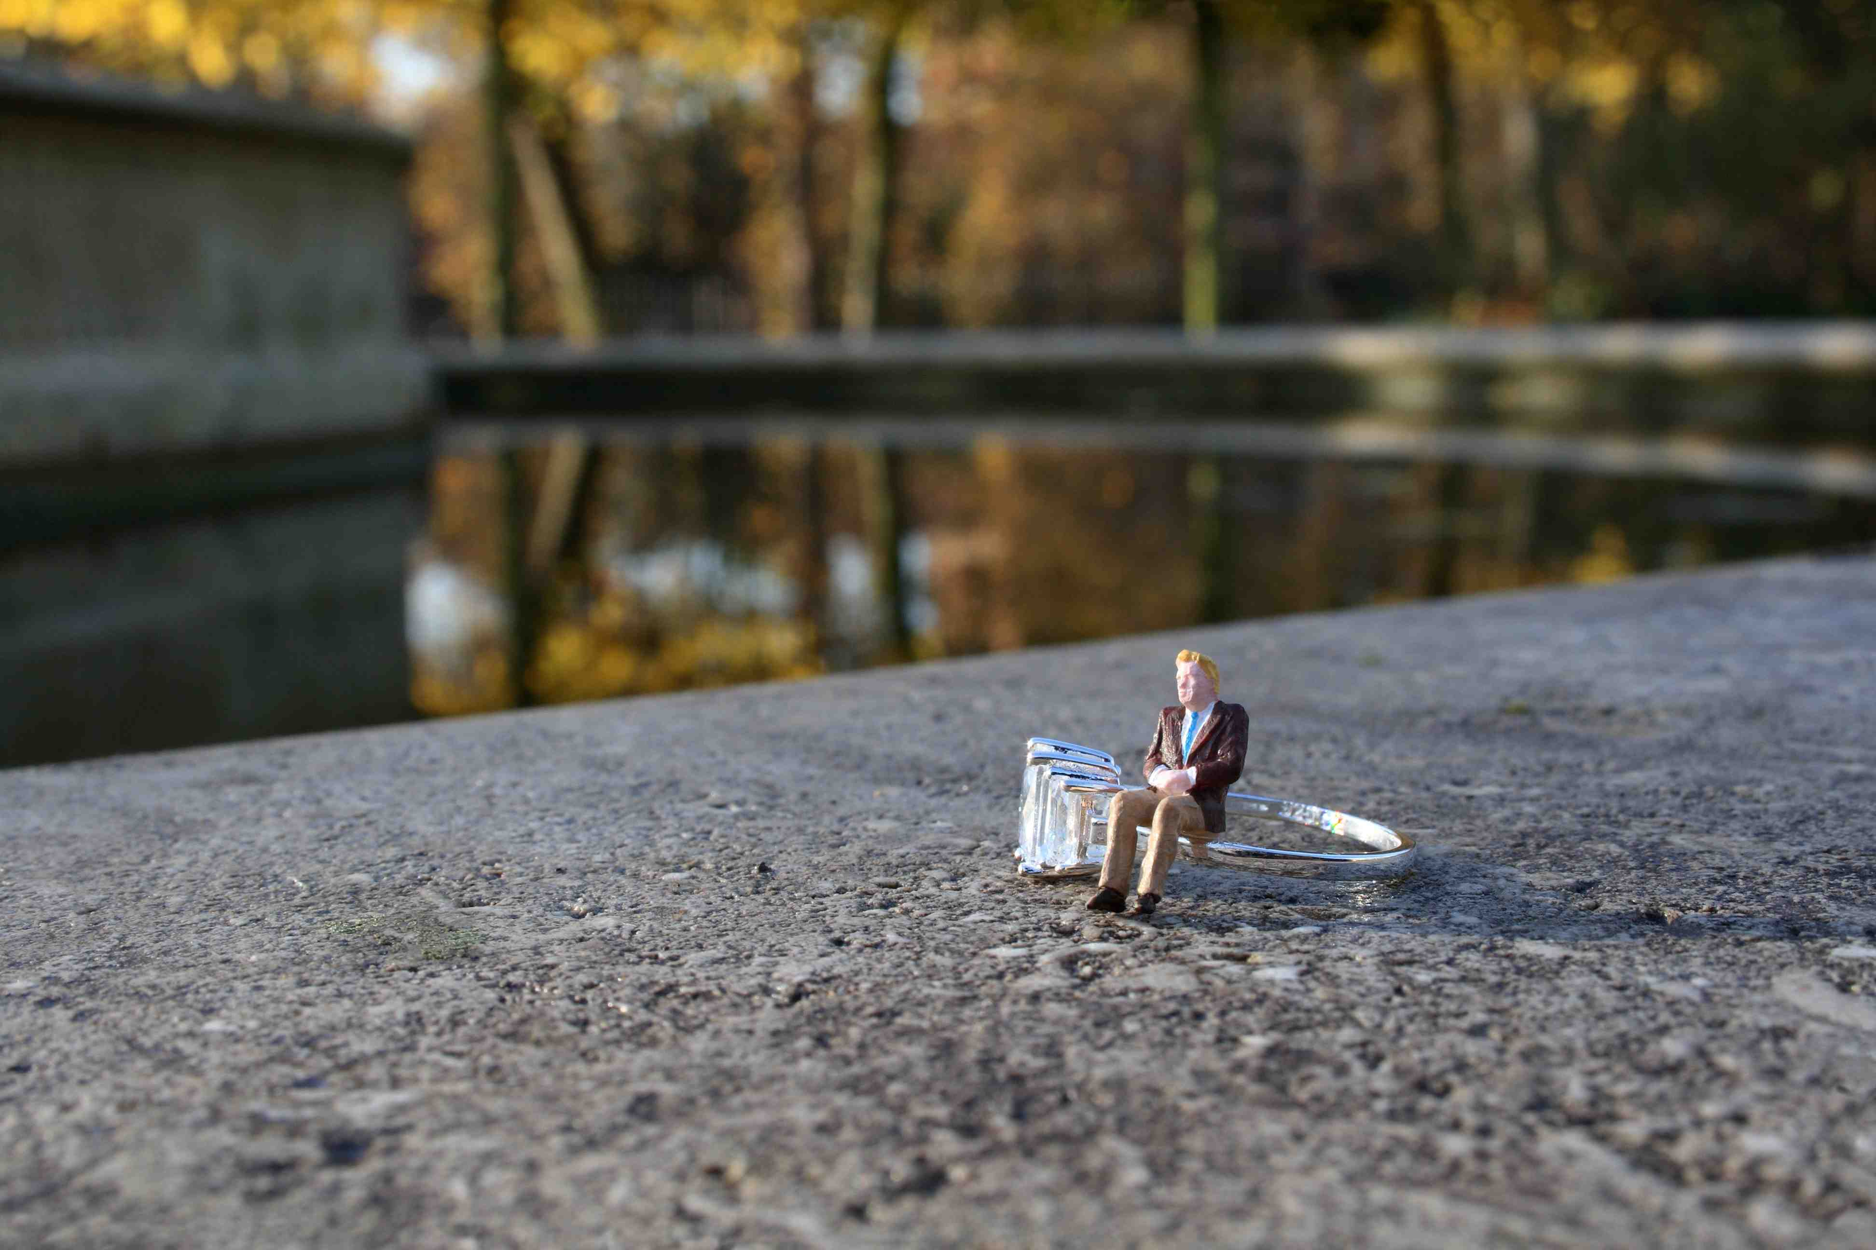

Slide 10
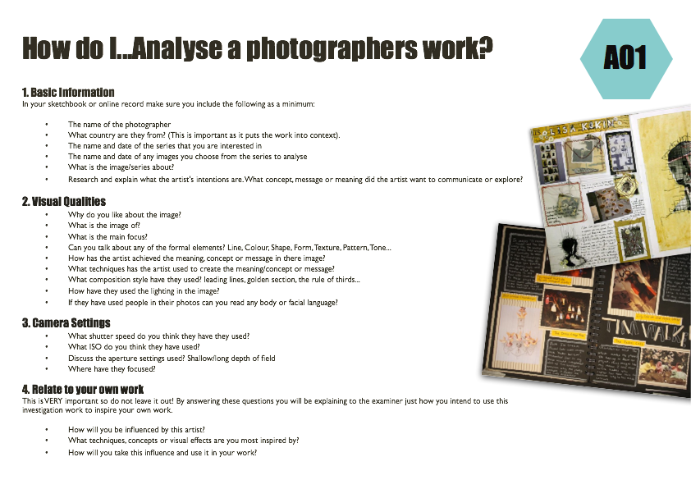
What is needed on the reference page:-
Creative Title
Minimum of 5 photographs of his work
Information about Slinkachu and his people project
Discussion of at least one photo in detail
Possible ideas they have based on his style of work
GCSE photography Progress Indicators
Basic Requirements | Described the work of Slinkachu Presented a selection of images by the photographer in your sketchbook Added the photographers name to the page
Good | Answered some questions from each heading on the ‘How do I…Analyse a Photographers work?’ sheet A range of neatly cut out and presented images by the photographer
Outstanding | Answered most questions from all the headings on the ‘How do I…Analyse a Photographers work?’ sheet Writing uses detailed and in-depth sentences Creative layout/design for the page used

Slide 11
Title:-
Little People Projects
To gain an understanding of the work of The Little People Projects
GCSE photography Progress Indicators
Basic Requirements | Described the work of Slinkachu/Tanaka Presented a selection of images by the photographer in your sketchbook Added the photographers name to the page
Good | Answered some questions from each heading on the ‘How do I…Analyse a Photographers work?’ sheet A range of neatly cut out and presented images by the photographer
Outstanding | Answered most questions from all the headings on the ‘How do I…Analyse a Photographers work?’ sheet Writing uses detailed and in-depth sentences Creative layout/design for the page used
TASK 1
Find information about Tanaka Tatsuya and Slinkachu. Find at least 6 images you like (3 of each) and print.
www.twistedsifter.com/2018/01/miniature-calendar-by-tatsuya-tanaka/
https://www.nippon.com/en/people/e00139/
TASK 2
Using the ‘Analysing photographers’ handout handwrite or type up your analysis of at least one of your found images for each photographer. – Discuss composition, possible camera settings and what you think is happening in the photo including your opinion
TASK 3
Write the photographers name – Creatively- on your A3 paper and creatively present the images and analysis and information.
Leave room on the page to discuss possible ideas (bullet points only – not detailed that is on photoshoot plan)

Slide 12
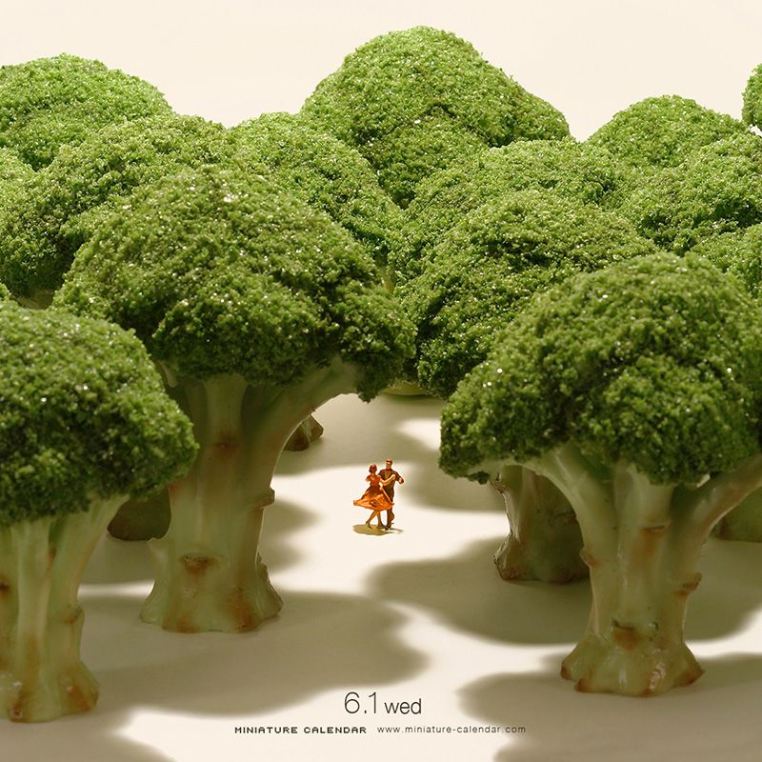
PLENERY
What can you NOW tell me about this photographer?
What camera settings of you think have been used in the image above?
How will you be influenced by this artist?

Slide 13

PLENERY
What can you NOW tell me about this photographer?
What camera settings of you think have been used in the image above?
How will you be influenced by this artist?

Slide 15

Peer Assessment
Reference Page
Using the sheet/table look through what your partner has done so far on their reference page and tick if completed fully
Glue the assessment to the back of their large paper and hand back for them to complete this lesson

Slide 16

Peer Assessment of Reference Page
Pass your reference page with the PIN sheet in a clockwise directions (to your left)
1st person – write a positive comment about their work – and NOT JUST it looks nice!!!
Pass the paper and PIN sheet to your left on your table
2nd person – write an improvement comment – something that might be missing
Pass both sheets back to the owner
Owner – to now say what they are going to do
next to improve/finish work
Glue to the back of your reference page
What is needed on the reference page:-
Creative Title
Minimum of 5 photographs of his work
Information about Slinkachu and his people project
Discussion of at least one photo in detail
Possible ideas they have based on his style of work

