Slide 1
DO NOW ACTIVITY
Identify one sport and explain how each classification (flat, long, short and irregular) of bone aids (helps) performance.
___ /8
Question 1: (start of the lesson)
………………………………………………………………………………………………………………………………………………………………………
Points =
Question 2: (END of the lesson)
………………………………………………………………………………………………………………………………………………………………………
Points =
NAME_____________________

Slide 2
DO NOW ACTIVITY
Without looking in your book create a question on ANYTHING you have learned this half term
*YOU WANT TO MAKE IT AS HARD AS POSSIBLE BUT YOU MUST KNOW THE ANSWER

Slide 5
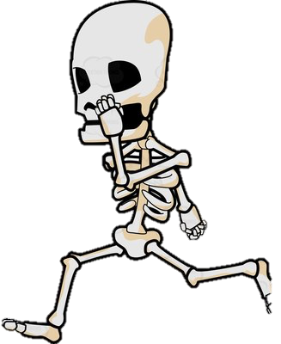
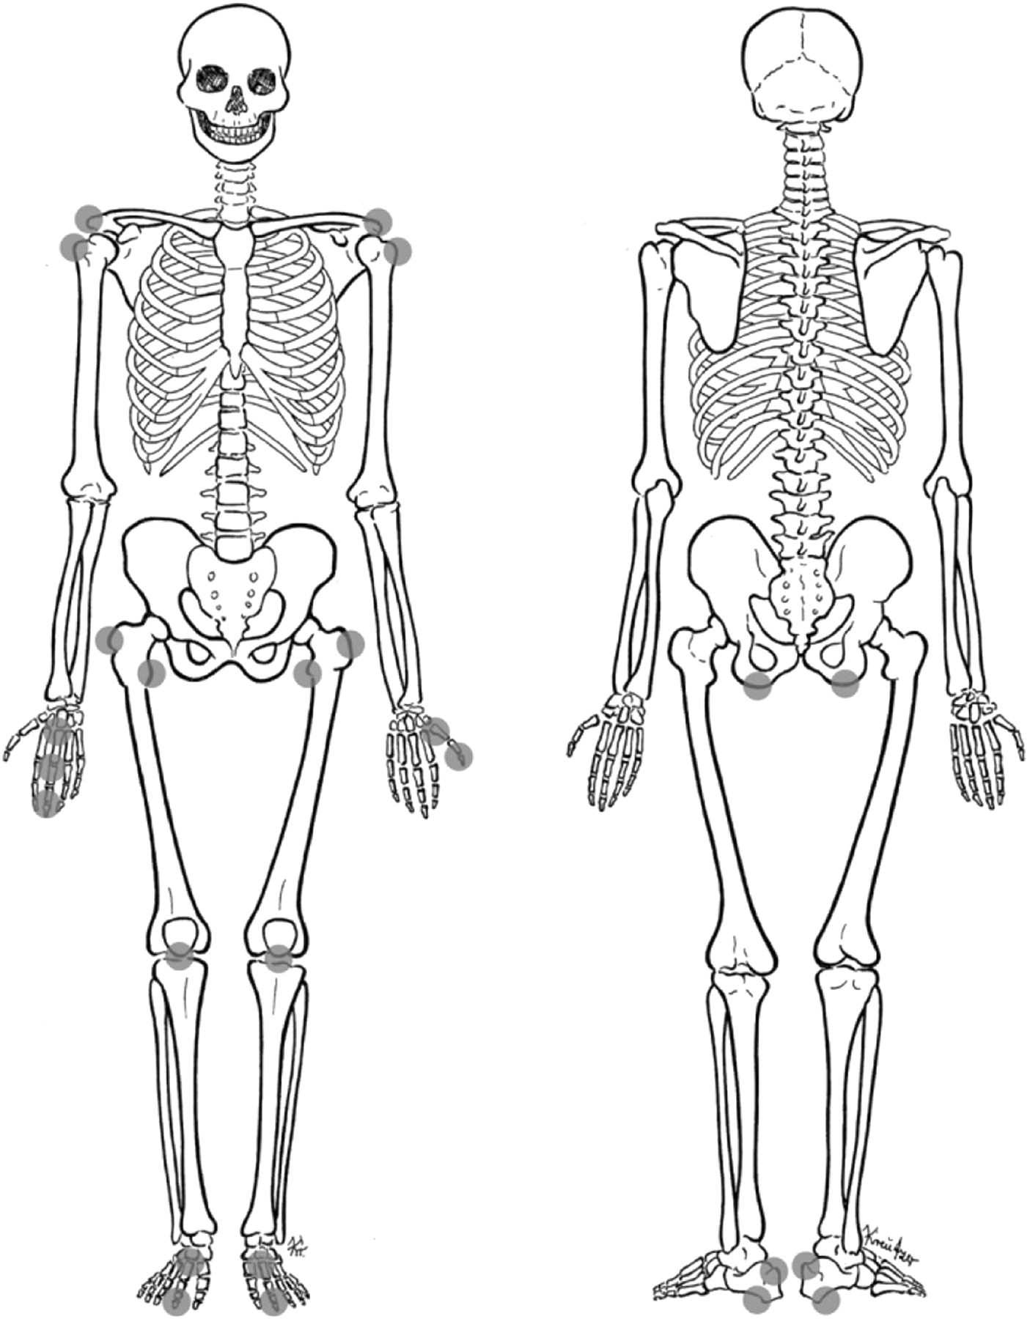
Atlas and axis
Cervical – (7)
Scapula
Cranium
Thoracic– (12)
Clavicle
Sternum
Lumbar– (5)
Ribs
Sacral– (5)
Vertebra
Coccygea /Coccyxl– (4)
Carpals
Pelvis
Humerus
Metacarpals
Ulna
Long Bone
Radius
Flat Bone
Femur
Irregular Bone
Phalanges
Short Bone
Fibula
tarsals
metatarsals
Patella
Tibia
Phalanges

Slide 6
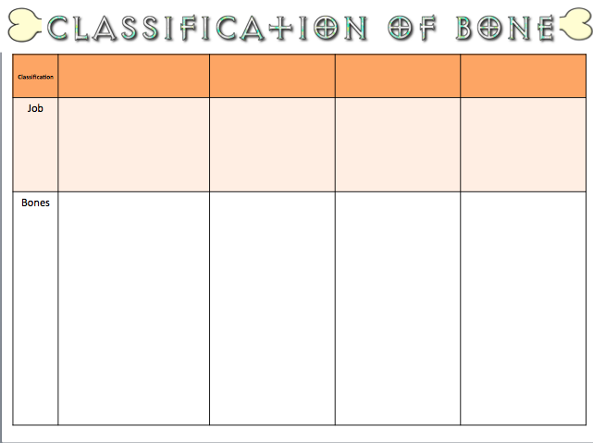

Slide 7
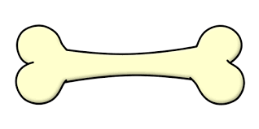
Classification | LONG | SHORT | IRREGULAR | FLAT
Job
Bones
Leverage , movement
Weight bearing
Protection, muscle attachment ,
Protection, broad surface for muscle attachment ,
Ulna
metatarsals
Carpals
Vertebra
Scapula
Phalanges – fingers and toes
tarsals
Clavicle
Cranium
Humerus
Tibia
Sternum
Femur
metacarpals
Patella
Fibula
Radius
Pelvis
Ribs
Demonstrate:
Identify one sport and explain how each classification (flat, long, short and irregular) of bone aids (helps) performance. (8 marks)

Slide 9
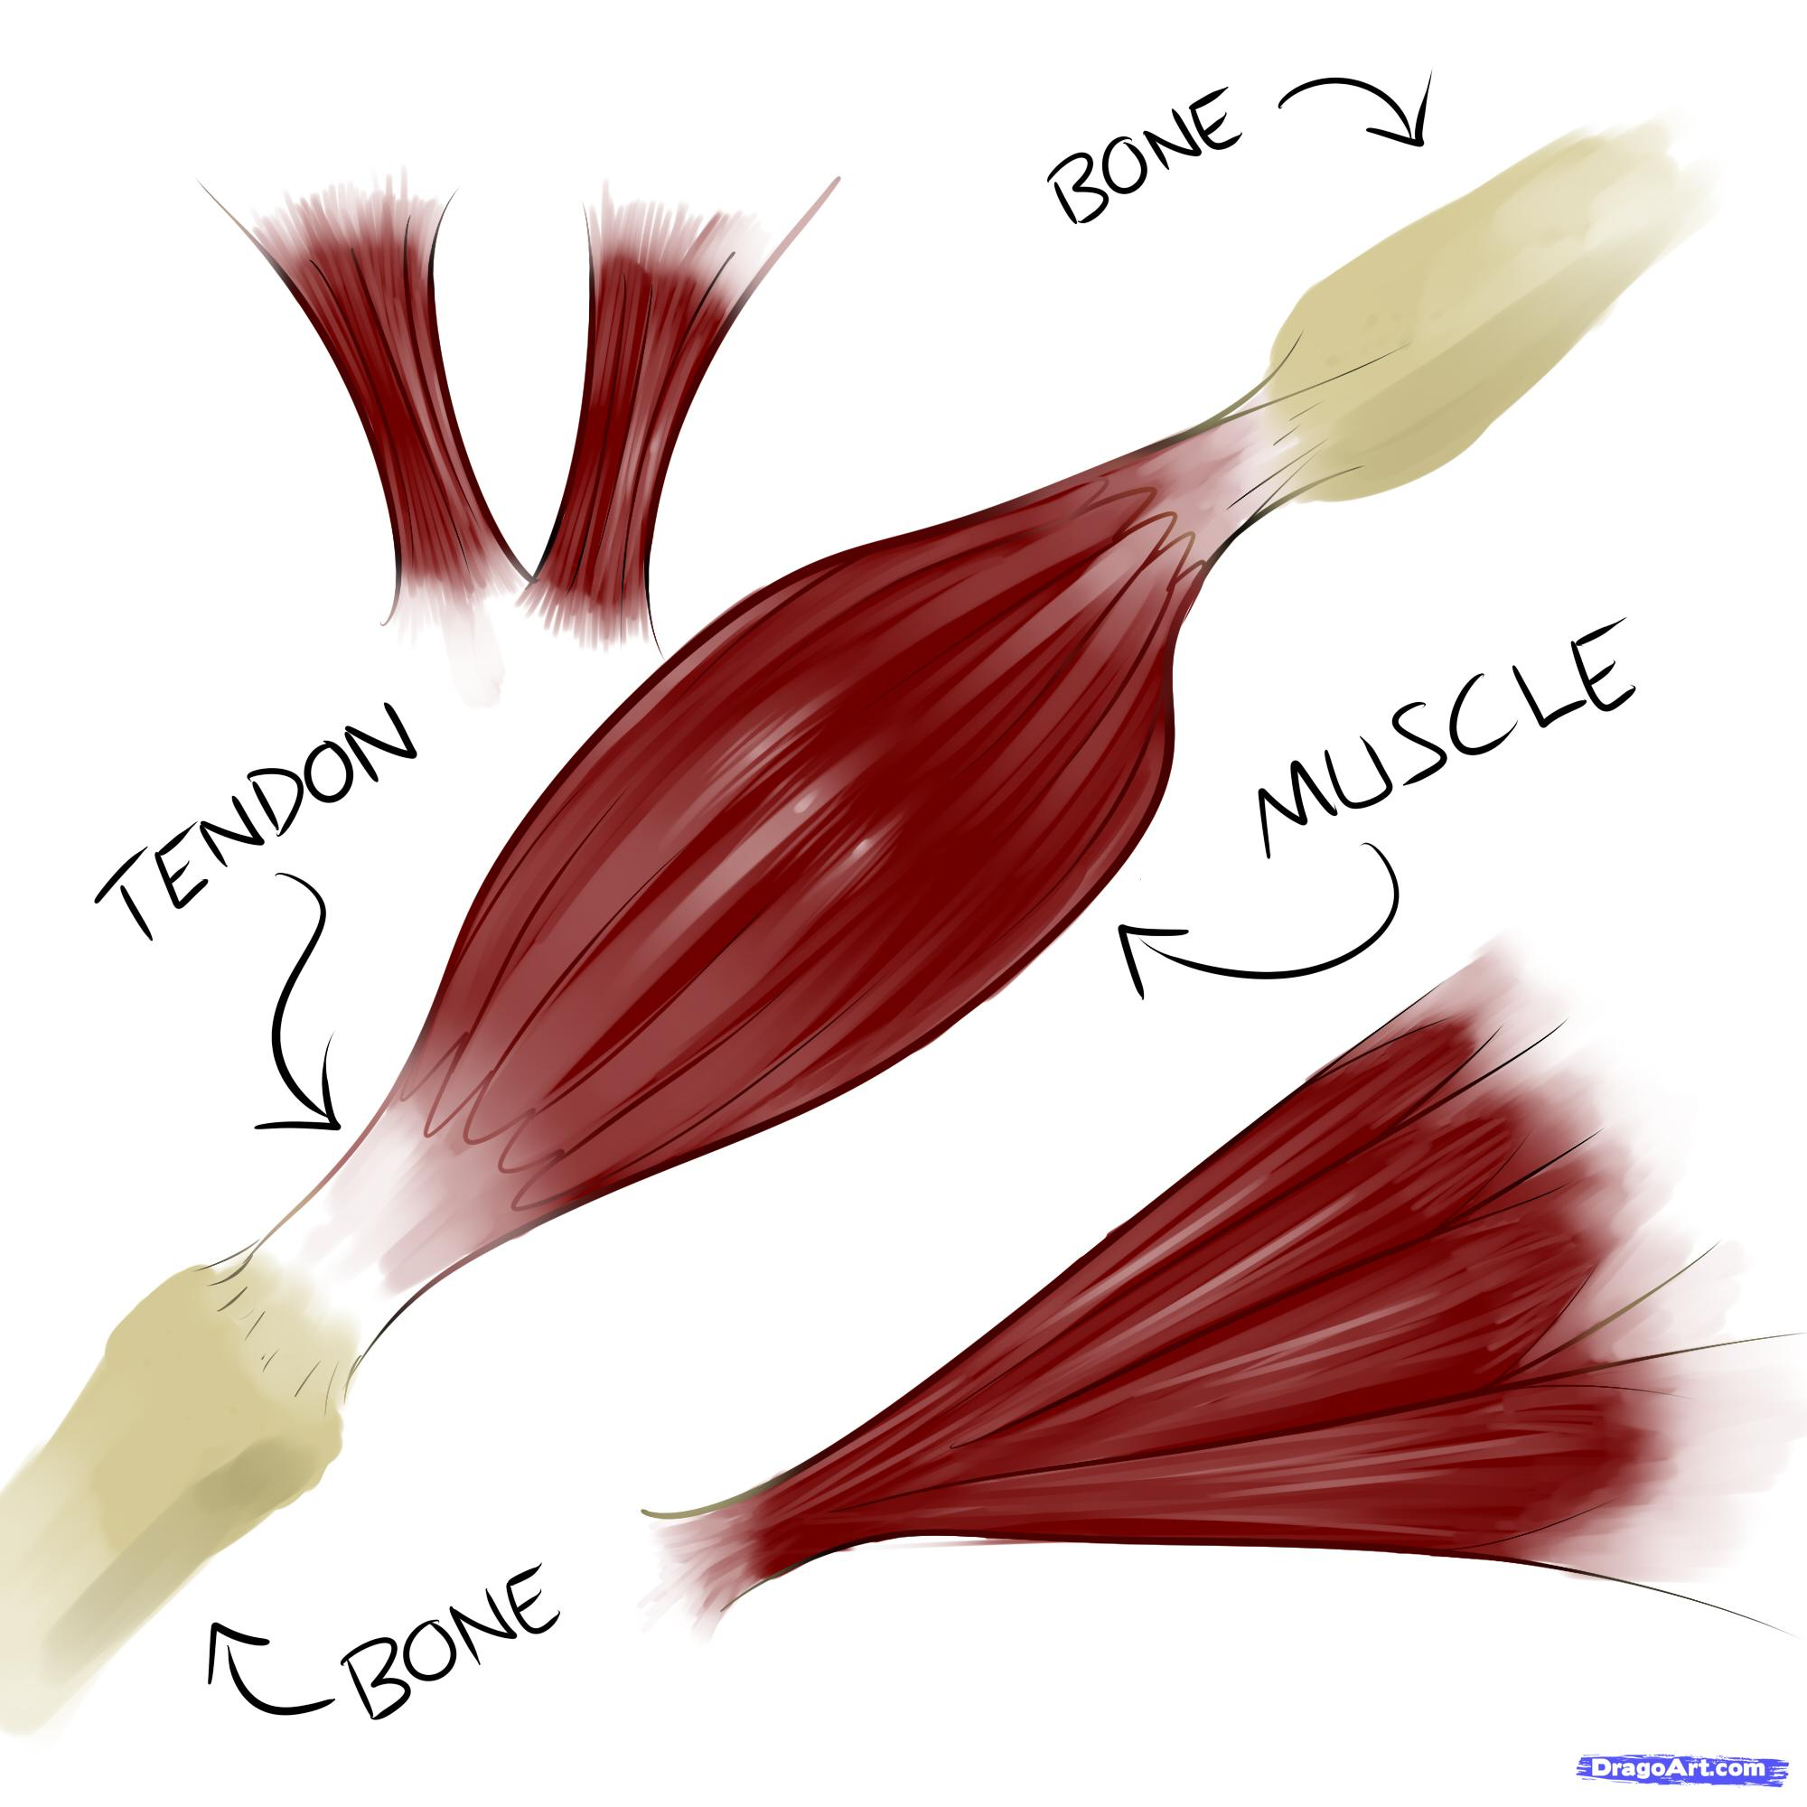
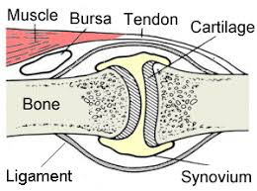
What is the job of each
How does it help in sport
Ligaments
Tendons
A ligament is an elastic band of tissue that connects bone to bone and provides stability to the joint
A ligament help in sport to prevent injuries and keep the body stable when running and jumping
remember
Like to Like
A tendon helps in sport as we wouldn’t be able to move without it, when a muscle contracts it pulls on the tendon that then moves the bone
A tendon is a band of tissue that connects muscle to bone to help movement happen when the muscles contract
Cartilage
Cartilage is a soft, gel-like padding between bones that protects joints and facilitates movement.
Cartilage help to lubricate the joint when running and jumping to prevent the bones from rubbing together and getting injured

Slide 11
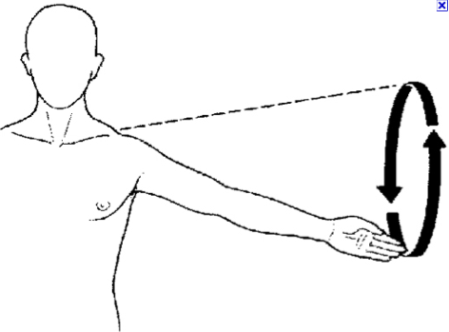
Types of Movement
Extension
Flexion
Adduction
Abduction
Opening a joint
Closing a joint
Moving towards the center line
Moving away the center line
Rotation
Circumduction
Plantar-Flexion
Dorsi-flexion
Clockwise or anticlockwise movement
Movement of a circular motion
Extension of the ankle
P = pointing
Flexion of the ankle

Slide 13
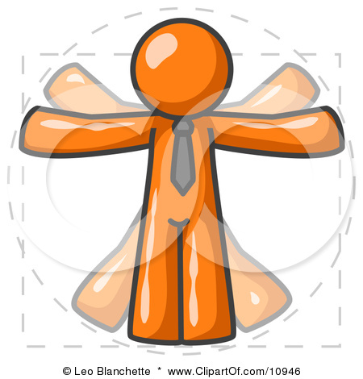
Each joint type allows for different movements
Type | Example | Flexion and Extension | Adduction and Abduction | Rotation | Circumduction
Ball and Socket
Hinge
Condyloid
Pivot
Hip
Shoulder
Knee,
ankle,
elbow
Wrist
Neck (atlas and axis)

Slide 18
Identify one sport and explain how each classification (flat, long, short and irregular) of bone aids (helps) performance. (8 marks)
Identify one sport and explain how each classification (flat, long, short and irregular) of bone aids (helps) performance. (8 marks)
Identify one sport and explain how each classification (flat, long, short and irregular) of bone aids (helps) performance. (8 marks)
Identify one sport and explain how each classification (flat, long, short and irregular) of bone aids (helps) performance. (8 marks)
Identify one sport and explain how each classification (flat, long, short and irregular) of bone aids (helps) performance. (8 marks)

Slide 19
NAME: ………………………………………………….
SCHOOL: ____________________________________
TEACHER: ____________________________________
GCSE PE
1.1 The structure and functions of the skeletal system
REVISION BOOKLET

Slide 27
NAME: ………………………………………………….
SCHOOL: ____________________________________
TEACHER: ____________________________________
GCSE PE
1.1 The structure and functions of the skeletal system
REVISION BOOKLET

Slide 28
Atlas and axis
Cervical – (7)
Scapula
Cranium
Thoracic– (12)
Clavicle
Sternum
Lumbar– (5)
Ribs
Sacral– (5)
Vertebra
Coccygea /Coccyxl– (4)
Carpals
Pelvis
Humerus
Metacarpals
Ulna
Long Bone
Radius
Flat Bone
Femur
Irregular Bone
Phalanges
Short Bone
Fibula
tarsals
metatarsals
Patella
Tibia
Phalanges

Slide 29
Classification | LONG | SHORT | IRREGULAR | FLAT
Job
Bones
Leverage , movement
Weight baring
Protection, muscle attachment ,
Protection, broad surface for muscle attachment ,
Ulna
metatarsals
Carpals
Vertebra
Scapula
Phalanges – fingers and toes
tarsals
Clavicle
Cranium
Humerus
Tibia
Sternum
Femur
metacarpals
Patella
Fibula
Radius
Pelvis
Ribs

Slide 30
What is the job of each
How does it help in sport
Ligaments
Tendons
A ligament is an elastic band of tissue that connects bone to bone and provides stability to the joint
A ligament help in sport to prevent injuries and keep the body stable when running and jumping
remember
Like to Like
A tendon helps in sport as we wouldn’t be able to move without it, when a muscle contracts it pulls on the tendon that then moves the bone
A tendon is a band of tissue that connects muscle to bone to help movement happen when the muscles contract
Cartilage
Cartilage is a soft, gel-like padding between bones that protects joints and facilitates movement.
Cartilage help to lubricate the joint when running and jumping to prevent the bones from rubbing together and getting injured

Slide 31
Types of Movement
Extension
Flexion
Adduction
Abduction
Opening a joint
Closing a joint
Moving towards the center line
Moving away the center line
Rotation
Circumduction
Plantar-Flexion
Dorsi-flexion
Clockwise or anticlockwise movement
Movement of a circular motion
Extension of the ankle
P = pointing
Flexion of the ankle

