Slide 1
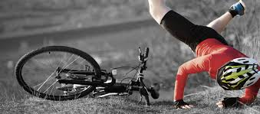
Sports Injuries
LO: to begin to understand the different injuries that can occur

Slide 2
Target – 3 – 4 – Give an explanation of possible injuries
Target – 5-7 – Give explanation and explain through sporting example
AIM HIGH! –Explain possible injuries with a sporting example linking it to ways you can reduce risk

Slide 3
During a basketball match you could get injured, explain what could happen (9)

Slide 4
You need to know 9 injury's
Definition AND explain how they can happen in a sport.
Write a big title and copy the definition and add your own sporting example.
NEAT!

Slide 5
Fractures
Simple (closed)
All happens under the skin.
Compound (open)
The broken end of the bones comes through the skin. Risk of infection!
Stress
Continuous stress over long periods results in small cracks in a bone, not sudden stress
Green stick (young)
Pressure or impact bends a bone but only partly breaks

Slide 6
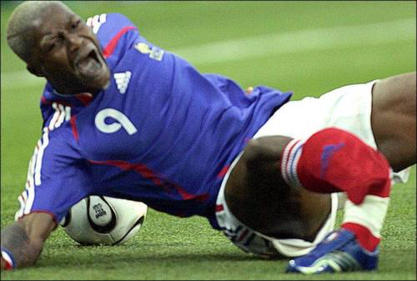
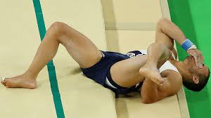
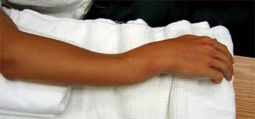
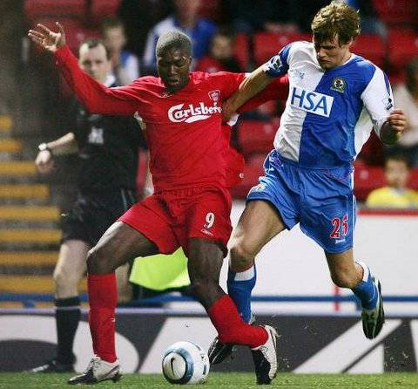
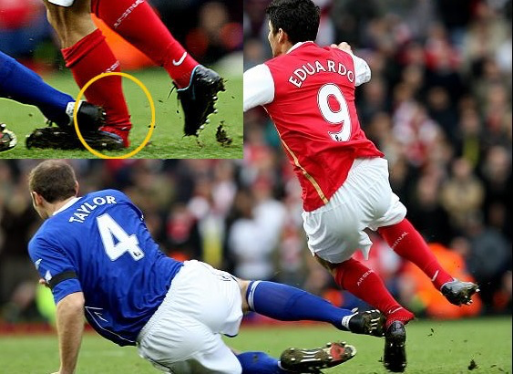

Slide 7
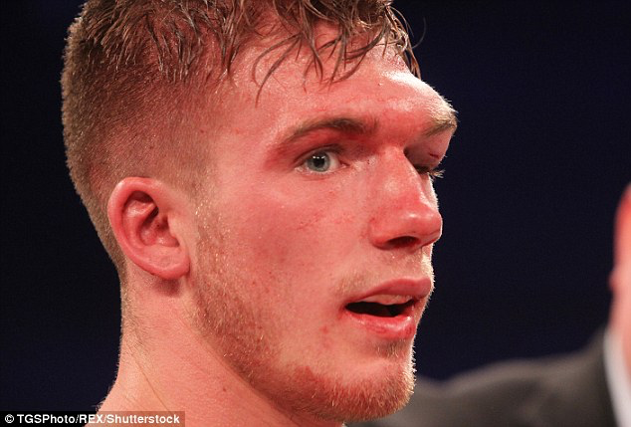
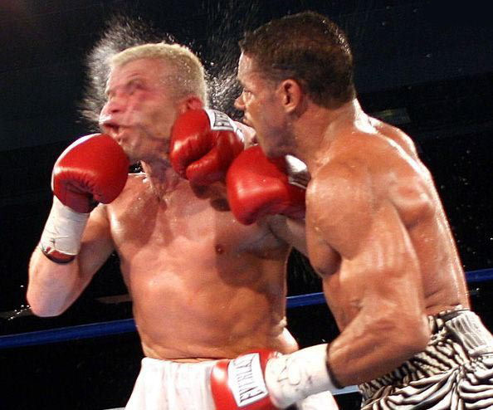
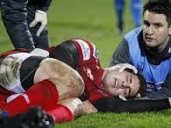
Concussion
Concussion is a mild brain injury caused by a blow to the head
Symptoms are disorientation, memory loss and possibly loss of concentration.

Slide 8
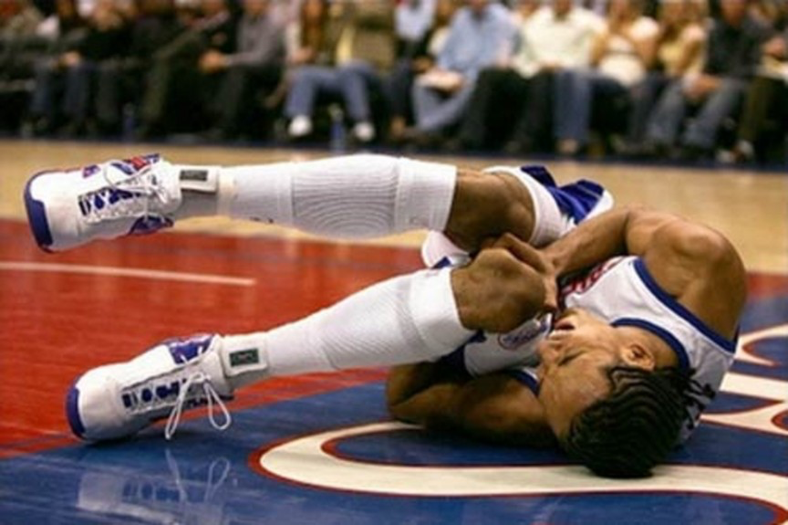
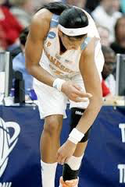
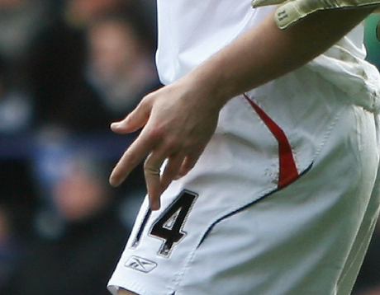
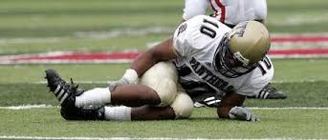
Dislocation
The bone is pulled out of its normal position

Slide 9
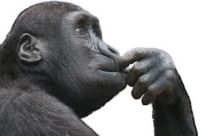
Wait! What is the link between these injuries?

Slide 10
Progress…. Where are you working?
3 – 4 – Give an explanation of possible injuries
5-7 – Give explanation and explain through sporting example
AIM HIGH! –Explain possible injuries with a sporting example linking it to ways you can reduce risk
Tell your partner what level they are working at
2 minutes, do each of these by explaining it to a partner

Slide 11
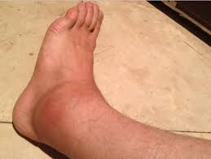
Sprains
Sprains - when ligaments are overstretched or torn around a joint, eg twisted or sprained ankle.

Slide 12
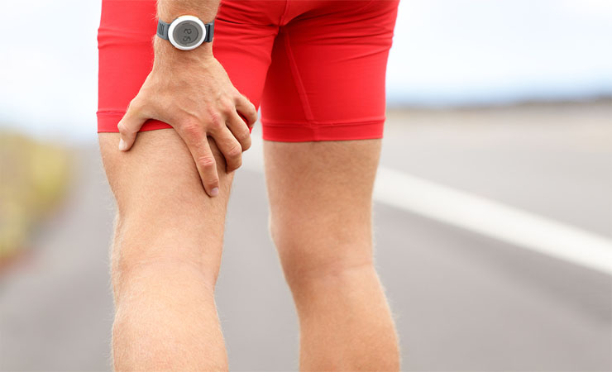
Strains
Strains - when a muscle or tendon is overstretched or torn, eg pulled muscle.

Slide 13
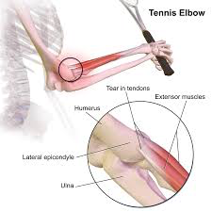
Tennis Elbow
Tennis Elbow - damage to tendons caused by overuse. It is a condition that causes pain around the outside of the elbow

Slide 14
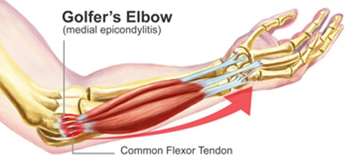
Golf Elbow
Golf Elbow - damage to tendons caused by overuse. It is a condition that causes pain around the inside of the elbow

Slide 15
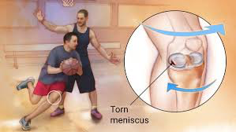
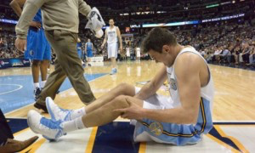
Torn Cartilage
Torn Cartilage - cartilage within the knee is most commonly injured. This happens through violent twisting or impacts which force the knee out of line.

Slide 16
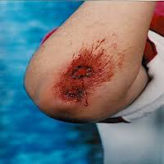
Abrasions
Grazes, blisters and chafing are all types of abrasions
They break the skin and cause bleeding
Cuts also break the skin

Slide 17
During a basketball match you could get injured, explain what could happen (9)
c
Target – 3 – 4 – Give basic explanation of possible injuries
Target – 5-7 – Give explanation and explain through sporting example
AIM HIGH! –Explain all possible injuries with a detailed sporting example linking it to ways you can reduce risk
K:drive
GCSE PE Mr Moody
‘Possible injuries online worksheet’
Extension – find 1 sporting picture for each of the 9 injuries

Slide 18
Target – 3 – 4 – Give an explanation of possible injuries
Target – 5-7 – Give explanation and explain through sporting example
AIM HIGH! –Explain possible injuries with a sporting example linking it to ways you can reduce risk

