Slide 1
Component 3 exam prep and revision
Good progress: To identify the physical factors and give examples.
Excellent progress: to demonstrate knowledge and understanding of the physical factors to a given scenario and apply the pies to show how it affects health and well being.

Slide 2
Component 3…
Do now..
*** PLEASE READ AND COPY ***
Your exam is on the 7th February 2020 (AM).
The duration is for 2 hours.
This is 40% of your overall grade.
The aims of the exam are:
AO1 Demonstrate knowledge and understanding of factors that affect health and wellbeing.
AO2 Interpret health indicators.
AO3 Design a person-centred health and wellbeing improvement plan.
AO4 Demonstrate knowledge and understanding of how to overcome obstacles relating to health and wellbeing improvement plans.

Slide 3
Physical factors…
Here are a list of physical and lifestyle factors:
Genetic inheritance
Ill health
Diet
Exercise
Substance use
Personal hygiene.
Can you find any factors in this exam?

Slide 4
Physical factors…
Here are a list of physical and lifestyle factors:
Genetic inheritance
Ill health
Diet
Exercise
Substance use
Personal hygiene.
Can you find any factors in this exam?

Slide 5
Genetic inheritance…
What is genetic inheritance?
This is when genes are passed from parent to child or children.
Example characteristics: | Example diseases:
Dimples | Cystic fibrosis
Eye colour | Sickle cell
Skin colour | Downs syndrome
 | Haemophilia
 | Muscular dystrophy
 | Huntingdon's disease

Slide 6
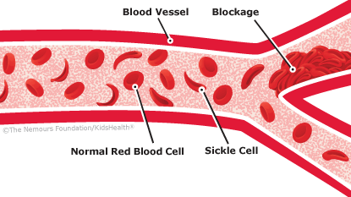
Genetic inheritance…task
Sickle Cell
Sickle cell anaemia (sickle cell disease) is a disorder of the blood caused by an inherited abnormal haemoglobin (the oxygen-carrying protein within the red blood cells). The abnormal haemoglobin causes distorted (sickled appearing under a microscope) red blood cells. The sickled red blood cells are fragile and prone to rupture.
Task:
You will need to create a mini PIES chart on how sickle cell can affect an individual in everyday life (8)…
Sickle Cell
Fatigue and anaemia
Pain crises
Swelling and inflammation of the hands and/or feet and arthritis
Bacterial infections
Sudden pooling of blood in the spleen and liver congestion
Lung and heart injury
Leg ulcers
Aseptic necrosis and bone infarcts (death of portions of bone)
Eye damage

Slide 7
Ill health…
G | T | O | E | O | K | V | V | N | B | R | H | S | K | G | S | A | B | E | W
P | A | E | F | Q | R | D | R | E | P | C | Z | I | L | E | X | S | U | G | W
E | S | A | E | S | I | D | Y | E | N | D | I | K | T | I | P | T | X | A | V
M | H | Z | Y | L | T | R | T | T | U | W | R | E | U | R | P | H | M | U | W
R | M | G | G | N | F | H | T | J | Z | J | B | J | H | D | F | M | D | D | C
S | B | T | D | Z | C | X | A | I | D | A | M | K | C | G | Q | A | M | G | N
V | E | M | V | C | E | I | U | B | I | E | Z | Y | I | L | E | O | Y | Q | R
Z | E | N | V | T | H | T | R | D | T | W | S | U | P | E | H | N | S | C | W
A | Q | J | O | I | I | B | K | N | T | T | U | H | U | M | E | S | F | K | I
R | F | D | F | B | Z | O | K | M | I | I | O | Q | Q | M | E | S | W | S | Z
C | N | M | V | F | N | F | L | C | E | Y | D | P | G | M | A | O | T | X | J
N | G | K | X | X | Z | E | F | R | O | T | V | K | D | O | I | V | F | O | H
Z | V | Q | L | S | O | I | K | X | I | U | L | F | N | D | N | R | W | B | M
V | S | P | B | Z | B | D | Z | O | Z | C | A | P | A | T | O | G | P | G | C
N | R | J | C | R | Z | U | T | A | R | J | K | N | I | H | M | R | J | O | V
U | F | X | O | W | Y | K | O | O | G | B | S | E | K | Y | U | P | L | A | K
I | L | S | E | P | I | L | E | P | S | Y | A | B | T | R | E | D | P | B | V
X | I | P | E | G | R | M | G | C | Z | J | S | W | R | S | N | Q | B | K | L
S | J | C | Z | X | R | C | I | B | U | H | H | U | Z | S | P | I | Y | X | E
R | H | F | M | H | A | K | A | P | K | U | P | Y | O | Z | F | R | S | J | O
What is Ill Health?
(Illness) A sickness that affects the body and mind. There are two types…
Acute – this is short term illness that can be cured.
Chronic – this is a long term illness that comes along gradually and can be treated but not cured.
Mini task:
Complete the word search on chronic and acute illnesses.
Create a key and highlight which ones are chronic and which ones are acute…
ASTHMA | BROKEN BONES | COLD
CYSTIC FIBROSIS | DIABETES | EPILEPSY
FLU | KIDNEY DISEASE | PNEUMONIA
RICKETS

Slide 8
Ill health…
G | T | O | E | O | K | V | V | N | B | R | H | S | K | G | S | A | B | E | W
P | A | E | F | Q | R | D | R | E | P | C | Z | I | L | E | X | S | U | G | W
E | S | A | E | S | I | D | Y | E | N | D | I | K | T | I | P | T | X | A | V
M | H | Z | Y | L | T | R | T | T | U | W | R | E | U | R | P | H | M | U | W
R | M | G | G | N | F | H | T | J | Z | J | B | J | H | D | F | M | D | D | C
S | B | T | D | Z | C | X | A | I | D | A | M | K | C | G | Q | A | M | G | N
V | E | M | V | C | E | I | U | B | I | E | Z | Y | I | L | E | O | Y | Q | R
Z | E | N | V | T | H | T | R | D | T | W | S | U | P | E | H | N | S | C | W
A | Q | J | O | I | I | B | K | N | T | T | U | H | U | M | E | S | F | K | I
R | F | D | F | B | Z | O | K | M | I | I | O | Q | Q | M | E | S | W | S | Z
C | N | M | V | F | N | F | L | C | E | Y | D | P | G | M | A | O | T | X | J
N | G | K | X | X | Z | E | F | R | O | T | V | K | D | O | I | V | F | O | H
Z | V | Q | L | S | O | I | K | X | I | U | L | F | N | D | N | R | W | B | M
V | S | P | B | Z | B | D | Z | O | Z | C | A | P | A | T | O | G | P | G | C
N | R | J | C | R | Z | U | T | A | R | J | K | N | I | H | M | R | J | O | V
U | F | X | O | W | Y | K | O | O | G | B | S | E | K | Y | U | P | L | A | K
I | L | S | E | P | I | L | E | P | S | Y | A | B | T | R | E | D | P | B | V
X | I | P | E | G | R | M | G | C | Z | J | S | W | R | S | N | Q | B | K | L
S | J | C | Z | X | R | C | I | B | U | H | H | U | Z | S | P | I | Y | X | E
R | H | F | M | H | A | K | A | P | K | U | P | Y | O | Z | F | R | S | J | O
What is Ill Health?
(Illness) A sickness that affects the body and mind. There are two types…
Acute – this is short term illness that can be cured.
Chronic – this is a long term illness that comes along gradually and can be treated but not cured.
Mini task:
Complete the word search on chronic and acute illnesses.
Create a key and highlight which ones are chronic and which ones are acute…
ASTHMA | BROKEN BONES | COLD
CYSTIC FIBROSIS | DIABETES | EPILEPSY
FLU | KIDNEY DISEASE | PNEUMONIA
RICKETS

Slide 9
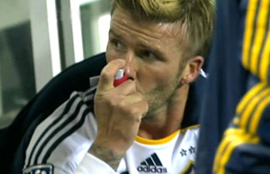
Ill health… task
David Beckham
David Robert Joseph Beckham is an English retired professional footballer and current President of Inter Miami and has suffered from Asthma since he was a small child, which means he would have played football with this chronic condition…
Task:
How would David Beckham have treated his Asthma (1)?
Why would it be treated and not cured (1)?
Using the signs and symptoms, create a mini PIES for David Beckham and how his Asthma would have affected his performance on the field (8).
Signs and symptoms:
Shortness of breath
Chest tightness or pain
Trouble sleeping caused by shortness of breath, coughing or wheezing
A whistling or wheezing sound when exhaling
Coughing or wheezing attacks that are worsened by a respiratory virus, such as a cold or the flu

Slide 10
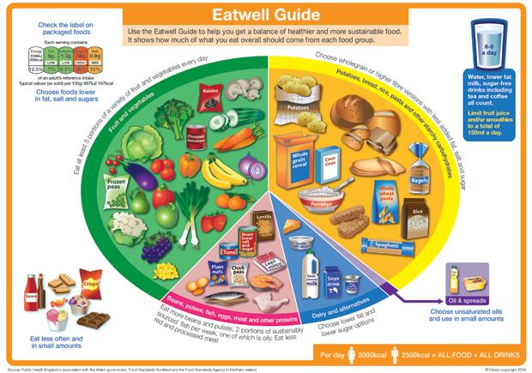
Diet…
What is a balanced diet?
A balanced diet is a diet that has the correct nutrients and the right proportions to keep you body and mind healthy…
Task – My diary
Make a list of what you had to eat and drink yesterday...
Colour code your food and drink to clearly see what nutrients you had yesterday…
Do you think your choices were healthy or unhealthy and explain your answer…

Slide 11
Diet… the eat well plate
The eat well guide says:
Eat at least 5 portions of fruit and vegetables a day.
Base meals on starchy foods (breads, rice and pasta).
Consume dairy once a day.
Consume protein once a day.
Eat a small amount of oil and spreads a day.
Drink plenty of fluids (8 glasses of water).
Reduce your salt, sugar and fat intake.

Slide 12
Diet… the eat well plate
Eating more than you need:
Obesity
Heart disease
High blood pressure
Strokes
Tooth decay
Cancer
Eating less than you need:
Anorexia
Anaemia (low iron count in the) blood
Stunted bone growth
Heart failure
Depression
Tiredness
Cancer
Rickets

Slide 13
Diet… task
Brian:
Six months ago Brian’s wife, Enid, died. She had been ill for several years. Brian visited her every day in the care home, where he got to know the staff well. He often stayed for breakfast and lunch, but since Enid’s death, he hasn’t been back to the care home and now started to buy/order in take-aways and fast food.
What will be the affects on Brian's health and well-being if he continues to eat this way (4)?
Using the eat well plate, suggest a healthy breakfast and lunch option for Brian (4)…

Slide 14
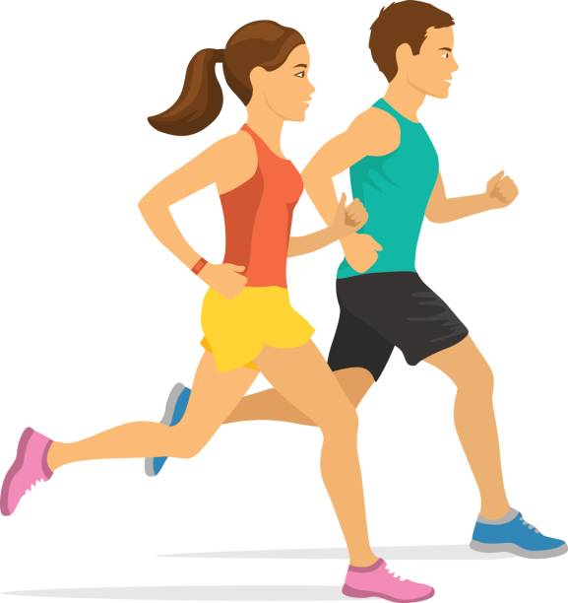
Exercise…
How exercise helps:
Exercise helps:
Improving your strength
Improving your stamina
Improving your muscles and body tone
You to concentrate
You to relieve stress
Relax and feel good
You to gain personal satisfaction
You to socialise with others.
What is exercise?
Exercise is used to maintain an individuals health and well being.

Slide 15
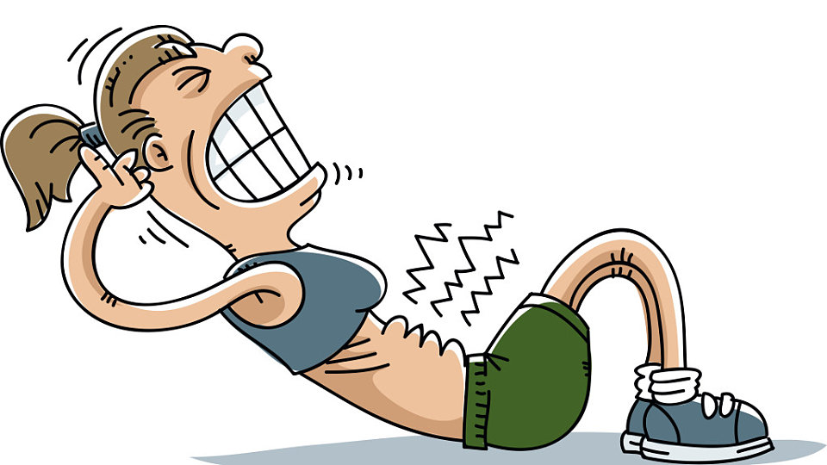
Exercise…
Not doing exercise:
Not doing exercise can:
Stiffen the joints.
Lead to poor stamina and strength.
Lead to obesity
Lead to strokes.
Lead to coronary heart disease
Lead to poorly developed heart and skeletal muscles.
Create a sluggish blood flow.
Lead to osteoporosis.
What is exercise?
Exercise is used to maintain an individuals health and well being.

Slide 16
Substance use…
What is substance use?
Is when an individual uses substances such as:
Alcohol
Smoking
Drugs (Illegal and prescription)
All these substances affect your health and well being in a negative way.

Slide 17
Substance use…task
Draw yourself a mini mind map and give as many examples as you can for alcohol, smoking and drugs (including prescription)…
Substance
Use
Smoking
Alcohol
Drugs (including prescription)

Slide 18
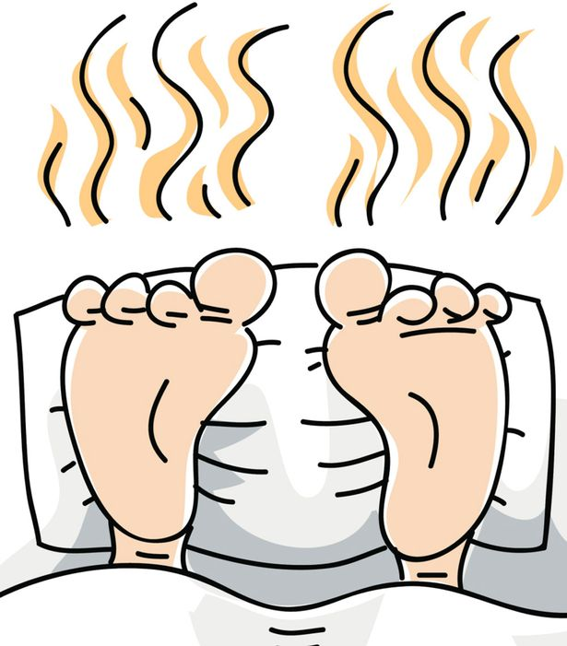
Personal hygiene…
What is personal hygiene?
Personal hygiene is when you maintain the cleanliness of your body and clothing to preserve your health and well-being.
Watch this video to show a bad example of personal hygiene and how it can affect your health and well being as well as others….
https://www.youtube.com/watch?v=yToii3-p-NI

Slide 19
Personal hygiene…task
Using the picture you have been given, you need to identify what needs personal hygiene needs to be maintained…

Slide 20
Personal hygiene…task
Using the picture you have been given, you need to identify what needs personal hygiene needs to be maintained…(4)

Slide 21
Personal hygiene…
Consequences of poor personal hygiene…
Growing bacteria can cause:
Food poisoning
Tetanus
Sore throats
TB
Whooping cough
Meningitis
Syphilis

